Slide 1
Network Layer
Network Layer Characteristics
IPv4 addressing
IPv6 addressing
Sub netting
Routing Protocols

Slide 2
Network Layer (3rd OSI Layer)
Concerned with getting packets from source to destination.
The network layer must know the topology of the subnet and choose appropriate paths through it.
It is responsible for the source-to-destination delivery of a packet, possibly across multiple networks.

Slide 3
Network Layer (3rd OSI Layer)
the data link layer oversees the delivery of the packet between two systems on the same network, the network layer ensures that each packet gets from its point of origin to its final destination.
If two systems are connected to the same local network, there is usually no need for a network layer.

Slide 4
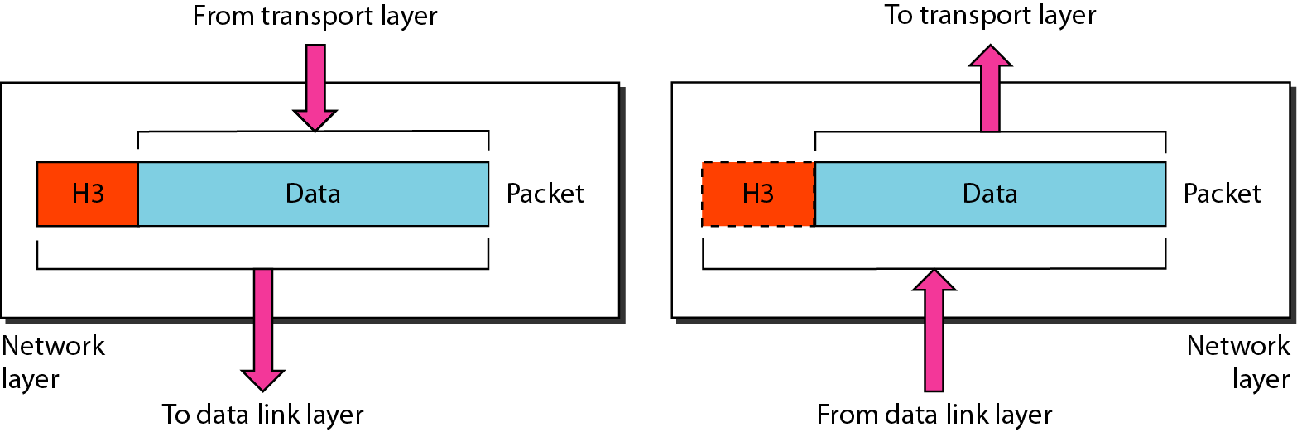
Contd.

Slide 5
Network Layer Functionalities
Logical addressing
The physical addressing implemented by the data link layer handles the addressing problem locally.
If a packet passes the network boundary, we need another addressing system to help distinguish the source and destination systems.
The network layer adds a header to the packet coming from the upper layer that, among other things, includes the logical addresses of the sender and receiver.

Slide 6
Contd.
Routing
When independent networks or links are connected to create internetworks (network of networks) or a large network, the connecting devices (called routers or switches) route or switch the packets to their final destination.
One of the functions of the network layer is to provide this mechanism.

Slide 7
Contd.
Internetworking
Internetworks are multiple networks that are connected in such a way that they act as one large network, connecting multiple office or department networks.
Internetworks are connected by networking hardware such as routers, switches, and bridges.
Internetworking is a solution born of three networking problems:
Isolated LANs
duplication of resources
the lack of a centralized network management system.

Slide 8
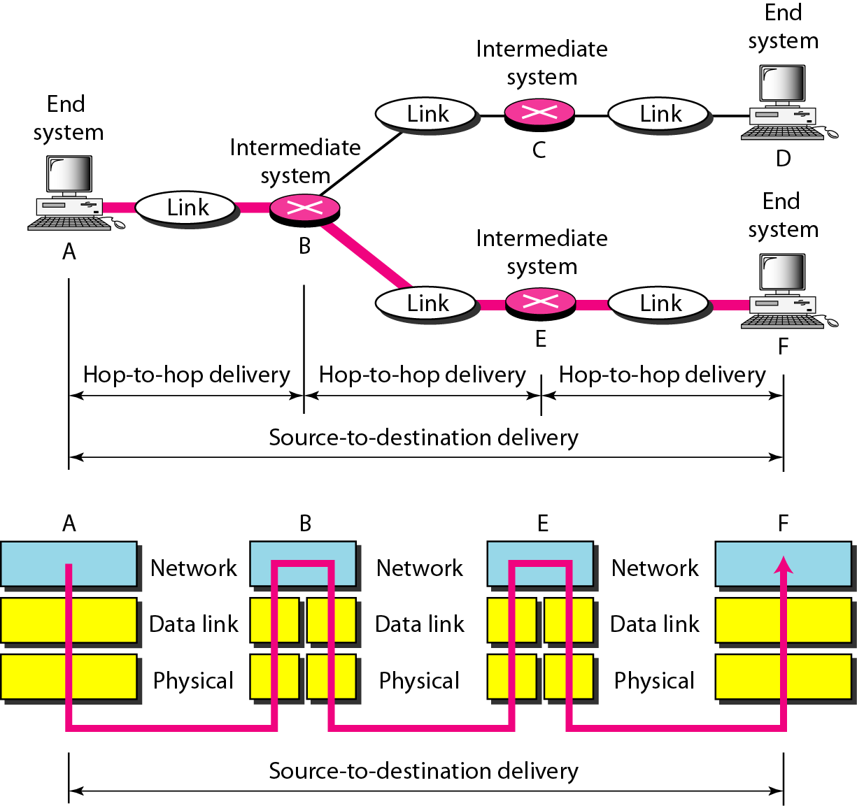
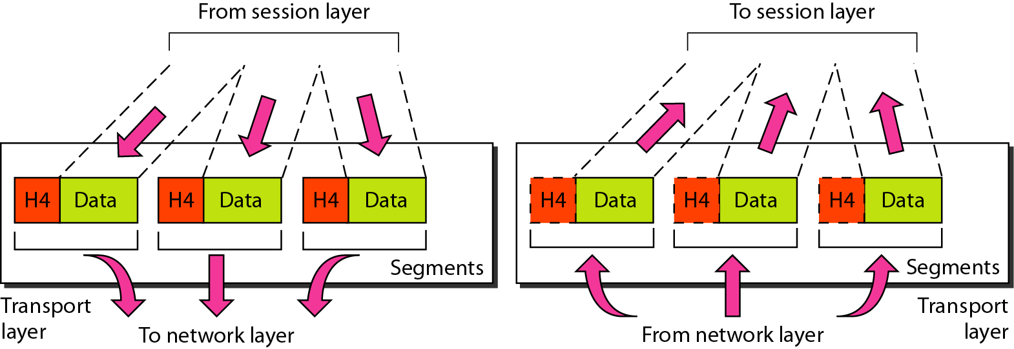

Slide 9
Internet Protocol (IP)
used for communicating data across a packet-switched internetwork using the IP Suite, also referred to as TCP/IP.
IP is the primary protocol in the Internet Layer of the Internet Protocol Suite
IP has the task of delivering distinguished protocol datagrams (packets) from the source host to the destination host solely based on their addresses.

Slide 10
Internet Protocol (IP)
IP defines addressing methods and structures for datagram encapsulation.
The first major version of addressing structure, now referred to as Internet Protocol Version 4 (IPv4) is still the dominant protocol of the Internet
although the successor, Internet Protocol Version 6 (IPv6), is being deployed actively worldwide (128 bits).

Slide 11
Contd.
Communication at the network layer is host-to-host (computer-to-computer);
a computer somewhere in the world needs to communicate with another computer somewhere else in the world. Usually, computers communicate through the Internet.

Slide 12
Contd.
The packet transmitted by the sending computer may pass through several LANs or WANs before reaching the destination computer.
For this level of communication, we need a global addressing scheme; we use the term IP address to mean a logical address in the network layer of the TCP/IP protocol suite.

Slide 13
IPv4 Addresses
An IPv4 address is a 32-bit address
IPv4 addresses are unique and universal.
They are unique in the sense that each address defines one, and only one, connection to the Internet.
Two devices on the Internet can never have the same address at the same time.

Slide 14
Address Space
An address space is the total number of addresses used by the protocol.
If a protocol uses N bits to define an address, the address space is 2^{N} because each bit can have two different values (0 or 1) and N bits can have 2^{N} values.

Slide 15
Address Space
IPv4 uses 32-bit addresses, i.e. the address space is 2³² or 4,294,967,296 (more than 4 billion).
if there were no restrictions, more than 4 billion devices could be connected to the Internet.
the actual number is much less because of the restrictions imposed on the addresses.

Slide 16
Notations
There are two prevalent notations to show an IPv4 address: binary notation and dotted-decimal notation.
Binary Notation
In binary notation, the IPv4 address is displayed as 32 bits.
Each octet is often referred to as a byte.
a 4-byte address.
an example of an IPv4 address in binary notation:
01110101 10010101 00011101 00000010

Slide 17
Notations
Dotted-Decimal Notation
To make the IPv4 address more compact and easier to read, Internet addresses are usually written in decimal form with a decimal point (dot) separating the bytes.
The following is the dotted-decimal notation of the above address:
117.149.29.2

Slide 18
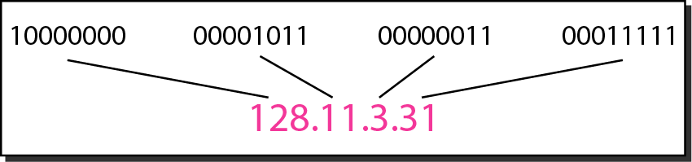
Notations: Example

Slide 19
Example 1
Change the following IPv4 addresses from binary notation to dotted-decimal notation
Solution
replace each group of 8 bits with its equivalent decimal number and add dots for separation.

Slide 20
Example 2
Change the following IPv4 addresses from dotted-decimal notation to binary notation.
Solution
Replace each decimal number with its binary equivalent.

Slide 21
Example 3
Find the error, if any, in the following IPv4 addresses.
Solution
There must be no leading zero (045).
There can be no more than four numbers.
Each number needs to be less than or equal to 255.
A mixture of binary notation and dotted-decimal notation is not allowed.

Slide 22
Class full and Classless addressing
Class full addressing is an IP address allocation method that allocates IP addresses according to five major classes(A-E).
Classless addressing is an IP address allocation method that is designed to replace classful addressing to minimize the rapid exhaustion of IP addresses.

Slide 23
Class full Addressing
IPv4 addressing, at its inception, used the concept of classes.
This architecture is called class full addressing.
In class full addressing, the address space is divided into five classes: A, B, C, D, and E.
Each class occupies some part of the address space.

Slide 24
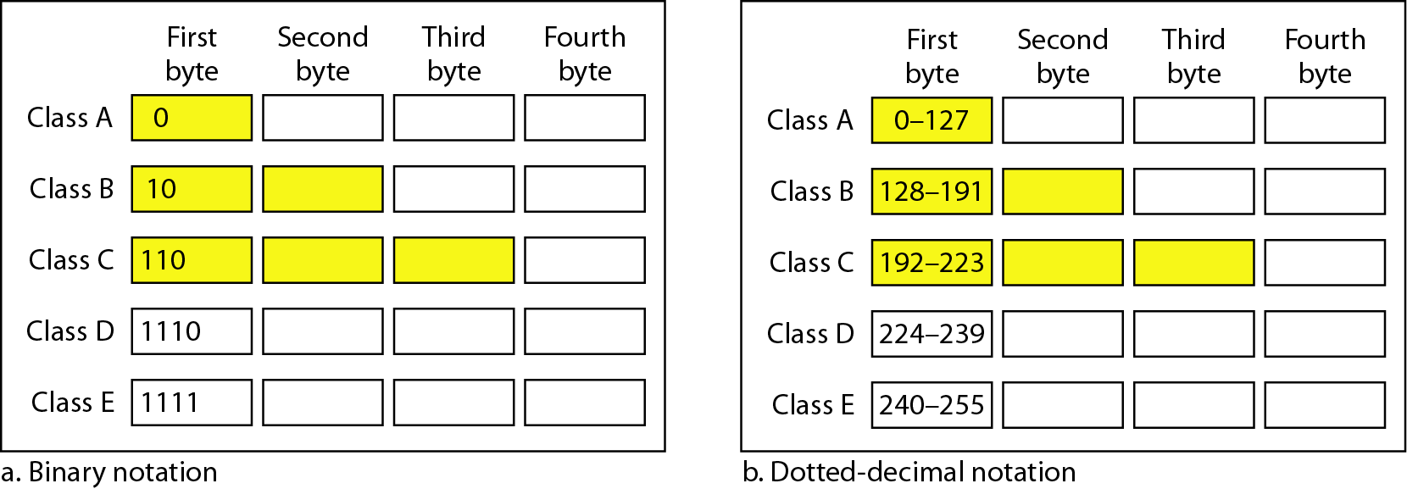
Classful Addressing

Slide 25
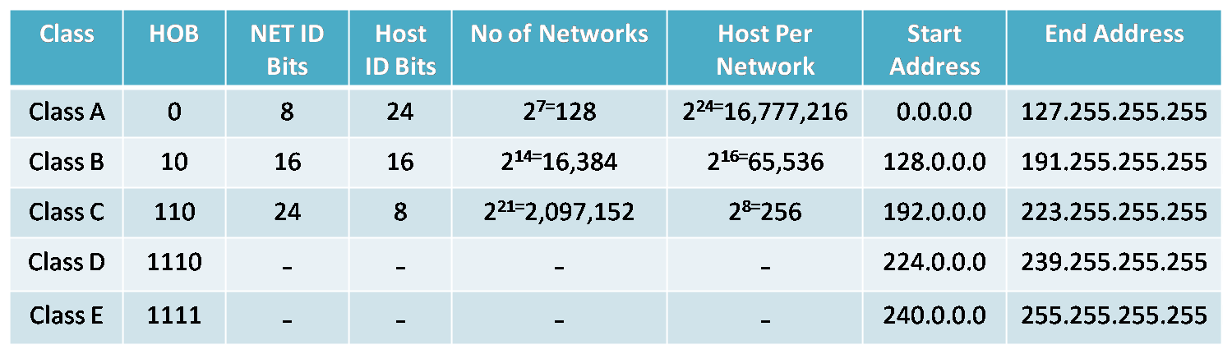

Slide 26
Public IP address | Private IP address
External (global) reach | Internal (local) reach
Used for communicating outside your private network, over the internet | Used for communicating within your private network, with other devices in your home or office
A unique numeric code never reused by other devices | A non-unique numeric code that may be reused by other devices in other private networks
Assigned and controlled by your internet service provider | Assigned to your specific device within a private network
Not free | Free
Any number not included in the reserved private IP address range Example: 8.8.8.8. | 10.0.0.0 — 10.255.255.255; 172.16.0.0 — 172.31.255.255; 192.168.0.0 — 192.168.255.255 Example: 10.11.12.13

Slide 27
Example 4
Find the class of each address.
a. 00000001 00001011 00001011 11101111
b. 11000001 10000011 00011011 11111111
c. 14.23.120.8
d. 252.5.15.111
Solution
a. The first bit is 0. This is a class A address.
b. The first 2 bits are 1; the third bit is 0. This is a class C address.
c. The first byte is 14; the class is A.
d. The first byte is 252; the class is E.

Slide 28
Classes and Blocks
One problem with class full addressing is that each class is divided into a fixed number of blocks with each block having a fixed size
Number of Blocks for class A = 2⁷
Number of Blocks for class B = 2¹⁴
Number of Blocks for class C = 2²¹
Block size for class A = 2²⁴
Block size for class B = 2¹⁶
Block size for class C = 2⁸
Notes:
2

Slide 29
Cont’d
0 [Zero] is reserved and represents all IP addresses.
127 is a reserved address and is used for testing, like a loop back on an interface.
255 is a reserved address and is used for broadcasting purposes.

Slide 30
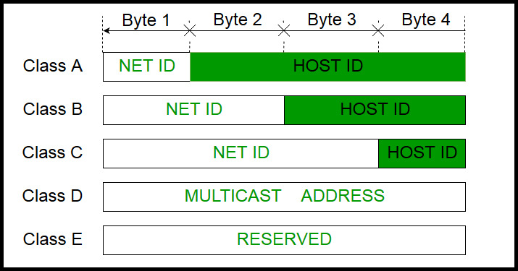
Network ID and Host ID

Slide 31
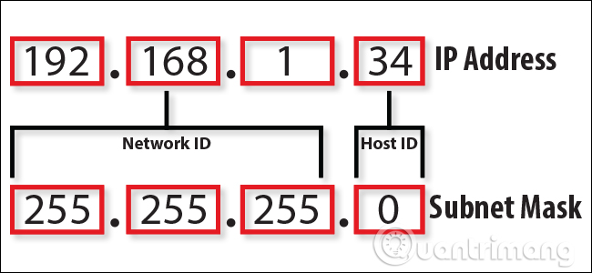
Mask

Slide 32
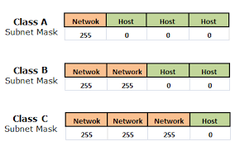
Mask
The mask can help us to find the network ID and the host ID.

Slide 33
Mask

Slide 34
Address Depletion
The flaws in class full addressing scheme combined with the fast growth of the Internet led to the near depletion of the available addresses.
Yet the number of devices on the Internet is much less than the 2³² address space. We have run out of class A and B addresses, and a class C block is too small for most midsize organizations.
One solution that has alleviated the problem is the idea of classless addressing.

Slide 35
Classless Addressing
To overcome address depletion and give more organizations access to the Internet, classless addressing was designed and implemented.
In this scheme, there are no classes, but the addresses are still granted in blocks.

Slide 36
Contd.
A block in class A address is too large for almost any organization. This means most of the addresses in class A were wasted and were not used.
A block in class B is also very large, probably too large for many of the organizations that received a class B block.
A block in class C is probably too small for many organizations.

Slide 37
Classless Addressing
Address Blocks
The size of the block (the number of addresses) varies based on the nature and size of the entity.
For example,
a household may be given only two addresses;
a large organization may be given thousands of addresses.
An ISP, as the Internet service provider, may be given thousands or hundreds of thousands based on the number of customers it may serve.

Slide 38
Restriction
To simplify the handling of addresses, the Internet authorities impose three restrictions on classless address blocks:
The addresses in a block must be contiguous, one after another.
The number of addresses in a block must be a power of 2 (1, 2, 4, 8 .... ).
The first address must be evenly divisible by the number of addresses.

Slide 39
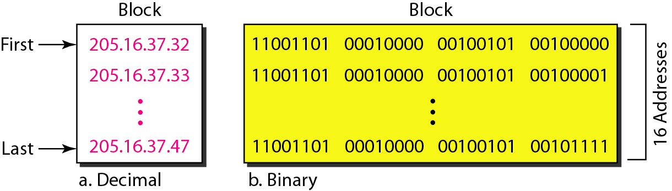
Restriction

Slide 40
Contd.
The above figure shows a block of addresses, in both binary and dotted-decimal notation, granted to a small business that needs 16 addresses.
We can see that the restrictions are applied to this block.
The addresses are contiguous.
The number of addresses is a power of 2 (16 = 2⁴)
the first address is divisible by 16. The first address, when converted to a decimal number, is 3,440,387,360, which when divided by 16 results in 215,024,210.

Slide 41
Classless addressing Mask
A better way to define a block of addresses is to select any address in the block and the mask.
As we discussed before, a mask is a 32-bit number in which the n leftmost bits are 1s and the 32 - n rightmost bits are 0s.
in classless addressing the mask for a block can take any value from 0 to 32. It is very convenient to give just the value of n preceded by a slash (CIDR – Classless Inter Domain Routing notation).

Slide 42
Classless addressing Mask
The address and the /n notation completely define the whole block (the first address, the last address, and the number of addresses).
In 1Pv4addressing,a block of addresses can be defined as x.y.z.t/n in which x.y.z.t defines one of the addresses and the /n defines the mask.

Slide 43
Classless addressing Mask
First Address:
The first address in the block can be found by setting the 32-n right most bits in the binary notation of the address to Os.
The last address in the block
can be found by setting the 32 - n rightmost bits in the binary notation of the address to 1s.
The number of addresses in the block
is the difference between the last and first address.
It can easily be found using the formula 2^{32-n}.

Slide 44
2 Power Table
2¹ | 2
2² | 4
2³ | 8
2⁴ | 16
2⁵ | 32
2⁶ | 64
2⁷ | 128
2⁸ | 256
2⁹ | 512
2¹⁰ | 1024
2¹¹ | 2048
2¹² | 4096
2¹³ | 8192
2¹⁴ | 16384

Slide 45
Example 5:
A block of addresses is granted to a small organization. We know that one of the addresses is 205.16.37.39/28.
What is the first address in the block?
What is the last address in the block?
The number of addresses in the block in the block?

Slide 46
Solution-Option 1
First Address
The binary representation of the given address is : 11001101 00010000 00100101 00100111
If we set 32−28 rightmost bits to 0, we get :
11001101 00010000 00100101 00100000
Or 205.16.37.32.

Slide 47
Solution-Option 1
Last Address :
The binary representation of the given address is
11001101 00010000 00100101 00100111
If we set 32 − 28 rightmost bits to 1, we get
11001101 00010000 00100101 00101111
or
205.16.37.47

Slide 48
Solution-Option 1
Number of Addresses :
The value of n is 28
Number of addresses is 2 ³²⁻²⁸ or 16.

Slide 49
Option Two
Another way to find the first address, the last address, and the number of addresses is to represent the mask as a 32-bit binary (or 8-digit hexadecimal) number.
This is particularly useful when we are writing a program to find these pieces of information. In the above example the /28 can be represented as
11111111 11111111 11111111 11110000
(twenty-eight 1s and four 0s).

Slide 50
Cont’d
Address : 11001101 00010000 00100101 00100111
Mask : 11111111 11111111 11111111 11110000
Find
a. The first address
b. The last address
c. The number of addresses.

Slide 51
Solution-Option 2
A. the first address :
The first address can be found by ANDing the given addresses with the mask.
ANDing here is done bit by bit.

Slide 52
Solution-Option 2
B. The last address:
can be found by ORing the given addresses with the complement of the mask.

Slide 53
Solution-Option 2
C. The number of addresses:
can be found by complementing the mask, interpreting it as a decimal number, and adding 1 to it.

Slide 54
Subnetting
During the era of class full addressing, subnetting was introduced.
If an organization was granted a large block in class A or B, it could divide the addresses into several contiguous groups and assign each group to smaller networks (called subnets) or, in rare cases, share part of the addresses with neighbors.
Subnetting increases the number of 1s in the mask.

Slide 55
Attributes of Subnetting
Network ID
Broadcast IP
First host IP
Last host IP
Next network
#IP addresses in each block
CIDR/subnet

Slide 56
Network Address and Host Address
When an organization is given a block of addresses, the organization is free to allocate the addresses to the devices that need to be connected to the Internet.
It defines the organization itself to the rest of the world.
The first address is the one that is used by routers to direct the message sent to the organization from the outside.

Slide 57
Network Address and Host Address
The Network address identifies the specific network to which host is attached, and Host address uniquely identifies a host within a network.
The distinction is important because router routes the packet according to a network address and don't care about host address.

Slide 58
Subnetting Types
FLSM (Fixed Length Subnet Masks) Subnetting | VLSM (Variable Length Subnet Masks) Subnetting
All subnets are equal in size. | Subnets are variable in size.
All subnets have equal number of hosts. | Subnets have variable number of hosts.
All subnets use same subnet mask. | Subnets use different subnet masks.
It is easy in configuration and administration. | It is complex in configuration and administration.
It wastes a lot of IP addresses. | It wastes minimum IP addresses.
It is also known as classfull Subnetting. | It is also known as classless Subnetting.
It supports both classfull and classless routing protocols. | It supports only classless routing protocols.

Slide 59
.0 /24 .255
.0 /25 .127
.128 /25 .255
/26
/26
/26
/26
/27
/27
/27
/27
/27
/27
/27
/27
/25
/27
/27
/26

Slide 60
Subnetting table
Subnet | 1 | 2 | 4 | 8 | 16 | 32 | 64 | 128 | 256
Host | 256 | 128 | 64 | 32 | 16 | 8 | 4 | 2 | 1
CIDR | /24 | /25 | /26 | /27 | /28 | /29 | /30 | /31 | /32
Subnet Mask | 0 | 128 | 192 | 224 | 240 | 248 | 252 | 254 | 255
3rd octate | /16 | /17 | /18 | /19 | /20 | /21 | /22 | /23 | /24
Example:
Given: 192.168.4.0/24
Required : 3 subnets

Slide 61
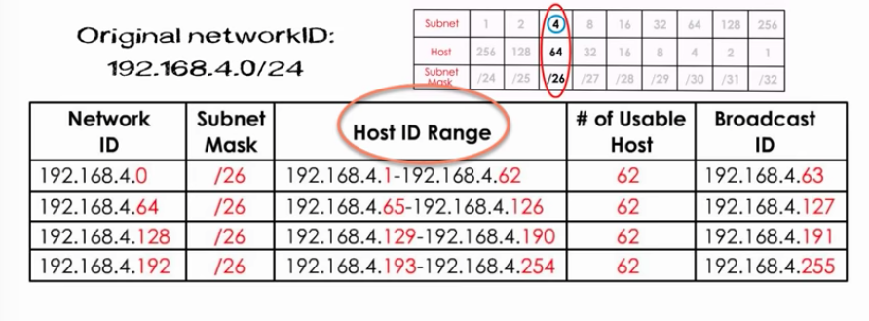
Cont’d
Solution

Slide 62
Exercise find all subnet attributes
10.1.1.55/28
Network ID: | 10.1.1.48
Broadcast IP: | 10.1.1.63
First host IP : | 10.1.1.49
Last host IP : | 10.1.1.62
Next network : | 10.1.1.64
#IP addresses in each block : | 16
CIDR/subnet | /28 250.250.240.0

Slide 63
Exercise find all subnet attributes
10.1.1.37/29
Network ID: | 10.1.1.32
Broadcast IP: | 10.1.1.39
First host IP : | 10.1.1.33
Last host IP : | 10.1.1.38
Next network : | 10.1.1.40
#IP addresses in each block : | 8
CIDR/subnet | /29 255.255.255.248

Slide 64
Exercise find all subnet attributes
10.2.2.20/30
Network ID: | 10.2.2.20
Broadcast IP: | 10.2.2.23
First host IP : | 10.2.2.21
Last host IP : | 10.2.2.22
Next network : | 110.2.2.24
#IP addresses in each block : | 4
CIDR/subnet | /27 255.255.255.252

Slide 65
Exercise find all subnet attributes
10.2.2.199/26
10.2.2.0 10.2.2.64 10.2.2.128 10.2.2.192 10.2.3.0 10.2.3.64 . . .

Slide 66
Exercise find all subnet attributes
10.2.2.199/26
Network ID: | 10.2.2.192
Broadcast IP: | 10.2.2.255
First host IP : | 10.2.2.193
Last host IP : | 10.2.2.254
Next network : | 10.2.3.0
#IP addresses in each block : | 64
CIDR/subnet | /26 255.255.255.192

Slide 67
Example
192.168.1.0
20 hosts
40 hosts
10 hosts
100 hosts

Slide 68
VLSM:100 hosts
2^{h}-2>=100
h=7
\value
8+8+8+(8-7)=25
Subnet mask
11111111.11111111.11111111.10000000
255.255.255.128
Block size
2⁷=128
Range: 192.168.1.0/25 -192.168.1.127/25

Slide 69
VLSM: 40 hosts
2^{h}-2>=40
h=6
\value
8+8+8+(8-6)=26
Subnet mask
11111111.11111111.11111111.11000000
255.255.255.192
Block size
2⁶=64
Range: 192.168.1.128/26 -192.168.1.191/26

Slide 70
VLSM : 20 hosts
2^{h}-2>=20
H=5
\value
8+8+8+(8-5)=27
Subnet mask
11111111.11111111.11111111.11100000
255.255.255.224
Block size
2⁵=32
Range: 192.168.1.192/27 -192.168.1.223/27

Slide 71
VLSM: 10 hosts
2^{h}-2>=10
H=4
\value
8+8+8+(8-4)=28
Subnet mask
11111111.11111111.11111111.11110000
255.255.255.240
Block size
2⁴=16
Range: 192.168.1.224/28 -192.168.1.239/28

Slide 72
VLSM
192.168.1.0/25 -192.168.1.127/25 for 100 hosts
192.168.1.128/26 -192.168.1.191/26 for 40 hosts
192.168.1.192/27 -192.168.1.223/27 for 20 hosts
192.168.1.224/28 -192.168.1.239/28 for 10 hosts

Slide 73
Example 6: Problem
Suppose an organization is given the block 17.12.14.0/26, which contains 64 addresses. The organization has three offices and needs to divide the addresses into three sub blocks of 32, 16, and 16 addresses.

Slide 74
Example 6: Solution
Suppose the mask for the first subnet is n1, then 2^{32-n1} must be 32, which means that n1 = 27.
Suppose the mask for the second subnet is n2, then 2^{32-n2} must be 16, which means that n2 = 28.
Suppose the mask for the third subnet is n3, then 2^{32-n3} must be 16, which means that n3 = 28.
This means that we have the masks 27, 28, 28 with the organization mask being 26.

Slide 75
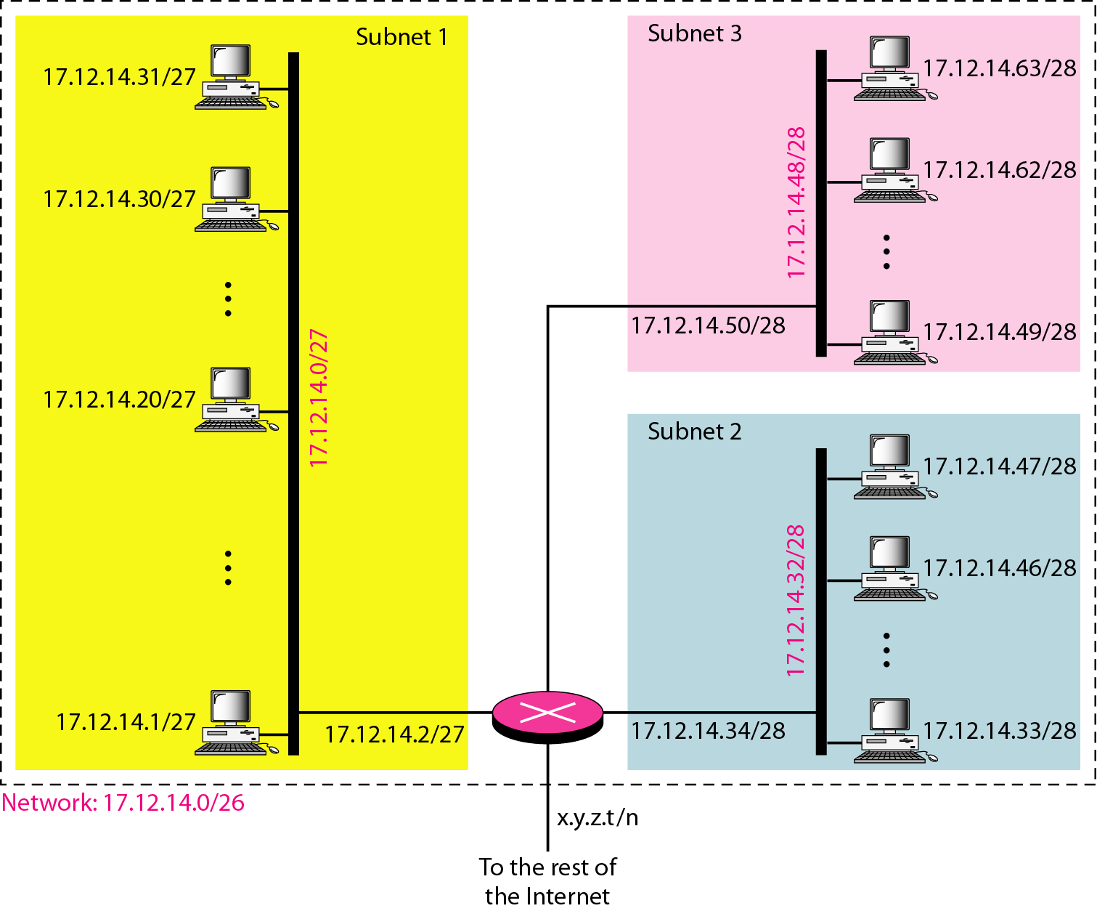

Slide 76
Address Allocation
The next issue in classless addressing is address allocation.
How are the blocks allocated?
The ultimate responsibility of address allocation is given to a global authority called the Internet Corporation for Assigned Names and Addresses (ICANN).
However, ICANN does not normally allocate addresses to individual organizations. It assigns a large block of addresses to an ISP.

Slide 77
Address Allocation
Each ISP, in turn, divides its assigned block into smaller sub blocks and grants the sub blocks to its customers.
In other words, an ISP receives one large block to be distributed to its Internet users. This is called address aggregation.
many blocks of addresses are aggregated in one block and granted to one ISP.

Slide 78
Example 7
An ISP is granted a block of addresses starting with 190.100.0.0/16 (65,536 addresses).
The ISP needs to distribute these addresses to three groups of customers as follows:
a. The 1st group has 64 customers; each needs 256 addresses.
b. The 2nd group has 128 customers; each needs 128 addresses.
c. The 3rd group has 128 customers; each needs 64 addresses.
Design the sub blocks and find out how many addresses are still available after these allocations.

Slide 79
solution
Group 1
For this group, each customer needs 256 addresses.
This means that 8 bits are needed to define each host.
The prefix length is then 32 − 8 = 24. The addresses are

Slide 80
solution
Group 2
For this group, each customer needs 128 addresses.
This means that 7 bits are needed to define each host.
The prefix length is then 32 − 7 = 25. The addresses are

Slide 81
Solution
Group 3
For this group, each customer needs 64 addresses. This means that 6 bits are needed to each host.
The prefix length is then 32 − 6 = 26. The addresses are
Number of granted addresses to the ISP: 65,536
Number of allocated addresses by the ISP: 40,960
Number of available addresses: 24,576

Slide 82
Reading Assignment:
How NAT works
What is NAT
Why NAT is important

Slide 83
IPv6 ADDRESSES
Despite all short-term solutions, address depletion is still a long-term problem for the Internet.
This and other problems in the IP protocol itself have been the motivation for IPv6.
An IPv6 address is 128 bits or 32 hexadecimal digits long.

Slide 84
Internet Protocol
IPV4 | IPV6
32 bit | 128 bit
4 octate | 8 blocks
Decimal Representation | Hexadecimal Representation
1 ocate -8 bit | 1 block -16bit
4*8 =32bit | 8*16 =128bit
Subnet mask | No subnet mask
5 classes | No class
Use broadcast address | Not use any broadcast
Contain 0-255 devices | Contain 65,536 (FFFF)
Security add on | Embedded Security

Slide 85
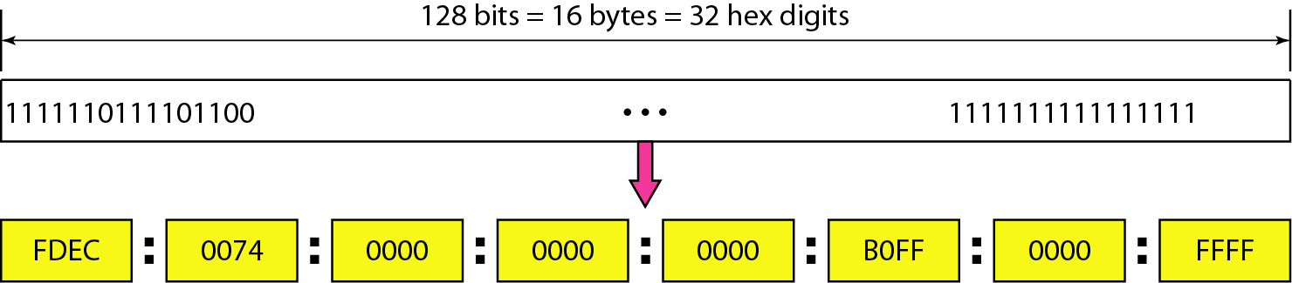
IPv6 ADDRESSES

Slide 86
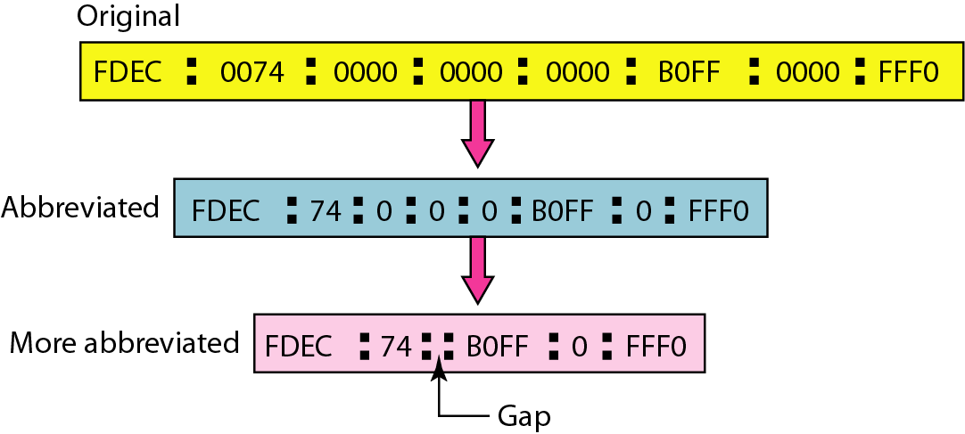
Abbreviated IPv6 addresses

Slide 87
Example 9
Expand the address 0:15::1:12:1213 to its original.
Solution
We first need to align the left side of the double colon to the left of the original pattern and the right side of the double colon to the right of the original pattern to find how many 0s we need to replace the double colon.
This means that the original address is.

Slide 88
What does a router do?
Find path
Forward packets

Slide 89
Routing vs Forwarding
Routing :
Building maps and giving directions
Forwarding:
Moving packets between interfaces according to the directions

Slide 90
IP Routing
Path derived from information received from a routing protocol
Several alternative paths may exist
best path stored in forwarding table
Decisions are updated periodically or as topology changes (event driven)
Decisions are based on:
topology
policies and metrics (hop count, filtering, delay, bandwidth, etc.)

Slide 91
IP Forwarding
Router decides which interface a packet is sent to
Forwarding table populated by routing process
Forwarding decisions:
destination address
class of service (fair queuing, precedence, others)
local requirements (packet filtering)
Forwarding is usually aided by special hardware

Slide 92
Contd.
The delivery of a packet to its final destination is accomplished by using two different methods of delivery, direct and indirect.
Direct delivery occurs when the source and destination of the packet are located on the same physical network or when the delivery is between the last router and the destination host

Slide 93
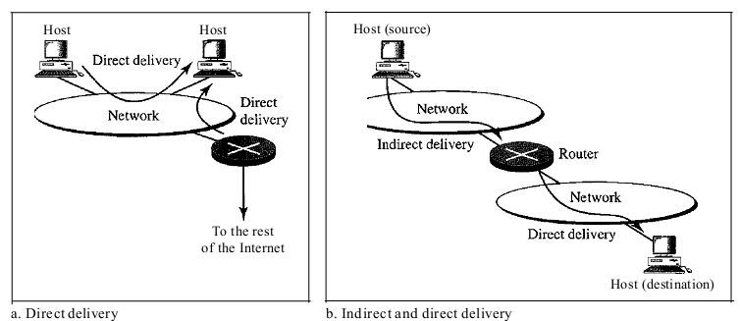
Contd.

Slide 94
Routing Table
A host/router has routing table with an entry for each destination, or combination of destinations, to route IP packets.
The routing table can be either static or dynamic.
Depending on network requirement we can use :
Static routing
Dynamic routing
a combination of both dynamic and static routing.

Slide 95
Static Routing Table
Contains information entered manually.
Administrator enters the route for each destination into table.
When a table is created, it cannot update automatically when there is a change in the Internet and the table must be manually altered by the administrator.
Can be used in small internet that doesn’t change very often, or in an experimental internet for troubleshooting.
It is poor strategy to use a static routing table in a big internet such as the Internet.

Slide 96
Dynamic Routing Table
Updated periodically by using one of the dynamic routing protocols such as RIP, OSPF, or BGP.
Whenever there is a change in the Internet, such as a shutdown of a router or breaking of a link, the dynamic routing protocols update all the tables in the routers (and eventually in the host) automatically.
The routers in a big internet such as the Internet need to be updated dynamically for efficient delivery of the IP packets.

Slide 97
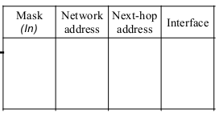

Routing Table Format
A routing table for classless addressing has a minimum of four columns.
However, some of today's routers have even more columns.
We should be aware that the number of columns is vendor-dependent, and not all columns can be found in all routers.

Slide 98
Routing Table Format
Mask:- defines the mask applied for the entry.
Network address:- defines network address to which packet is finally delivered.
Next-hop address:- defines address of next-hop to which packet is delivered
Interface:- shows the name of the interface.
Flags:- on/off switches that signify either presence/absence. There 5 flags
U (up):- indicates the router is up and running
G (gateway):- means that the destination is in another network
H (host-specific):- indicates that the entry in the network address field is a host-specific address.
D (added by redirection):- indicates that routing information for this destination has been added to the host routing table by a redirection message from ICMP.
M (modified by redirection):- indicates that the routing information for this destination has been modified by a redirection message from ICMP.
Reference count:- gives the number of users of this route at the moment.
Use:- shows the number of packets transmitted through this router

Slide 99
Routing Protocols
Routing protocols have been created in response to the demand for dynamic routing tables.
A routing protocol is a combination of rules and procedures that lets routers in the internet inform each other of changes.
It allows routers to share whatever they know about the internet or their neighborhood.

Slide 100
Routing Protocols
Routing protocols insure that packet takes the best path from these paths.
To accomplish this task, a router will need to perform following:
Learn about the directly connected routers on its interface
Find the networks that they have
Build routing table from this information
Choose best network from routing table to send the packet

Slide 101
Purpose of Dynamic Routing Protocols
Routing Protocols are used to facilitate the exchange of routing information between routers.
The purpose of dynamic routing protocols includes:
Discovery of remote networks
Maintaining up-to-date routing information
Choosing the best path to destination networks
Ability to find a new best path if the current path is no longer available

Slide 102
Routing Updates
Routing update is a mechanism of sharing information with neighboring routers.
In a particular time duration router advertise its routing information through broadcast or multicast.
Different protocols have different time intervals.
Routing updates contain all necessary information for routing protocol such as learned network, timers, AS, AD, matrix values, interface details etc.

Slide 103
Types of Routing Protocols
Routing Protocols
Intra domain
Distance vector
Link state
Inter domain
Path vector
RIP
OSPF
BGP

Slide 104
Intra and Inter domain Routing
Today, an internet can be so large that one routing protocol cannot handle task of updating the routing tables of all routers.
For this reason, an internet is divided into autonomous systems (AS)

Slide 105
Autonomous systems (AS)
AS is a group of networks and routers under the authority of a single administration.
AS is a boundary line for routing protocol.
It could be your company, or group of companies.
It is defined by a numeric value.
To distinguish between different AS, Internet Assigned Numbers Authority (IANA) provides a range from 1 to 65535.

Slide 106
Intra domain vs Inter domain
Routing inside an autonomous system is referred to as intra domain routing (Interior gateway protocols (IGPs))
routing between autonomous systems is referred to as inter domain routing (Exterior gateway protocols (EGPs) ).
Each AS can choose one or more intra domain routing protocols to handle routing inside the AS. However, only one inter domain routing protocol handles routing between autonomous systems

Slide 107
Intra domain vs Inter domain
Some examples of IGPs are:
RIPv1
RIPv2
EIGRP
IGRP
OSPF
Example of EGPs is Border Gateway Protocol (BGP).

Slide 108
Distance Vector Routing
It uses distance (metric value) and direction (vector) to find the best path to destination network
In distance vector routing, the least-cost route between any two nodes is the route with minimum distance.
In this protocol, as the name implies, each node maintains a vector (table) of minimum distances to every node.
Shortest path

Slide 109
Distance Vector Routing
The table at each node also guides the packets to the desired node by showing the next stop in the route (next-hop routing).
We can think of nodes as the cities in an area and the lines as the roads connecting them.
A table can show a tourist the minimum distance between cities.

Slide 110
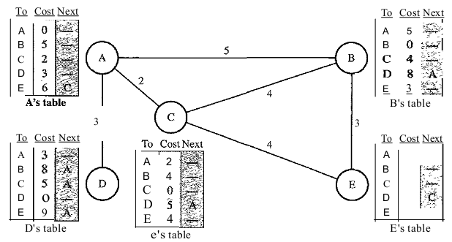
Cont….

Slide 111
Link State Routing
Link state routing protocols use more composite metric to locate the best path for destination network.
It maintains three separate tables.
First table keeps track of directly connected neighbors.
Second table determines the entire network topology
the third is the routing table that keeps actual path.
The node can use Dijkstra's algorithm to build a routing table
best path (consider the speed of the link)
OSPF is the example of link state protocol

Slide 112
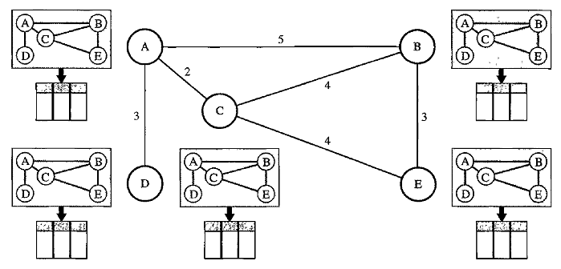
Cont….

Slide 113
Distance vector and Link State
Distance Vector
Link State
Routers communicate with neighbor routers advertising networks as measures of distance and vector
Distance =metric , vector=direction(interface)
Knowledge of the network from directly connected neighbors
Send periodic updates of entire routing table
Best for simple, flat design ,non hierarchical networks ,minimum administration knowledge , convergence time is not an issue
Routers communicate with all other routers exchanging link state information to build a topology or the entire network
Link-state=interface connections or “links” to other routers and networks
Routers have a complete view of the network ,knowledge of the entire topology
Send triggered partial updates
Best for large, hierarchical networks ,advanced administration knowledge ,convergence time is crucial

Slide 114
Thank You

